Slide 1
External Material Implementation of Linear Elasticity

Slide 2
External Materials in COMSOL Multiphysics
User-defined material models written in C-code can be used in COMSOL Multiphysics through an External Materials socket
This allows you to program your own material models and distribute them as add-ons
The code needs to be compiled into a shared library (e.g., dll for Windows)
Use on Linux and Mac OS X requires recompilation of the source code
For further details, see the section Working with External Materials in the COMSOL Multiphysics Reference Manual as well as the section Using External Materials in the documentation of the Structural Mechanics Module.
The latter also includes documentation of a library of utility functions that is available in order to simplify the implementation

Slide 3
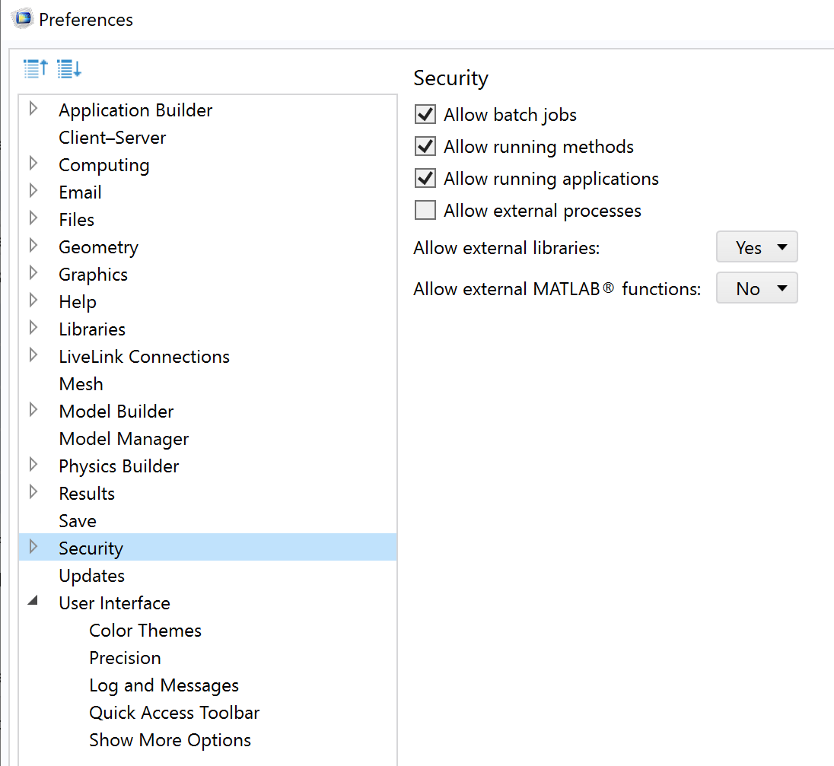
Working with External Materials in COMSOL Multiphysics
Before starting, go to File->Preferences->Security and set “Allow external libraries” to Yes.
For security reasons, external processes and libraries are disabled by default in a new COMSOL Multiphysics installation

Slide 4
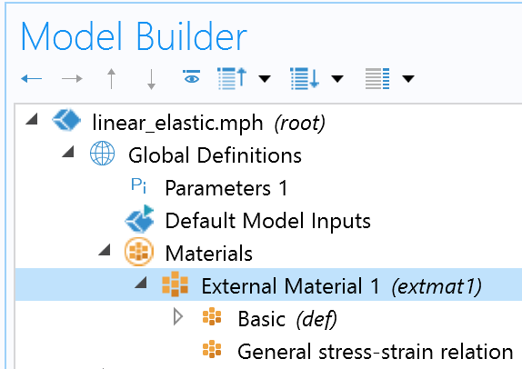
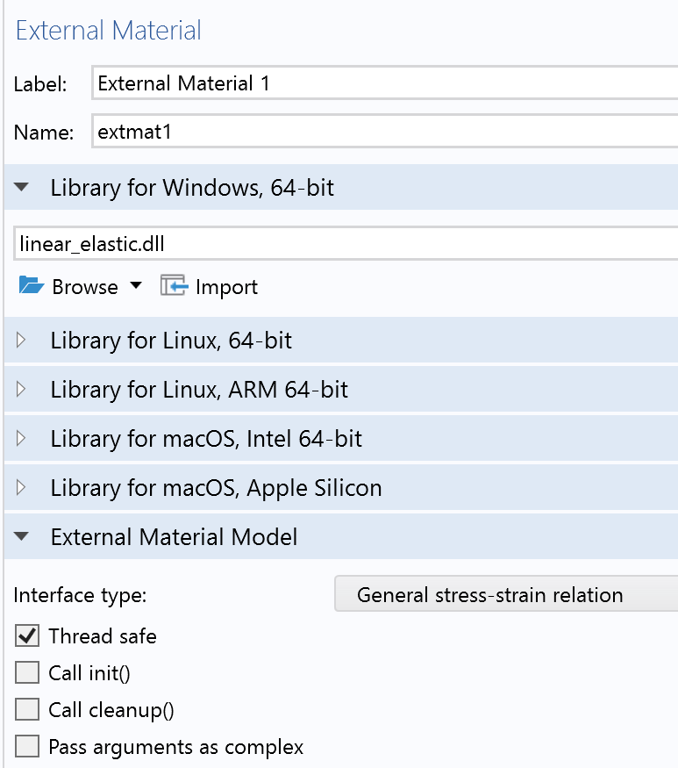
Linking an External Material
In the Materials node under Global Definitions, add an External Material
In the settings window, link the shared library according to the system architecture
Select the interface type according to the type of material relation you have implemented

Slide 5
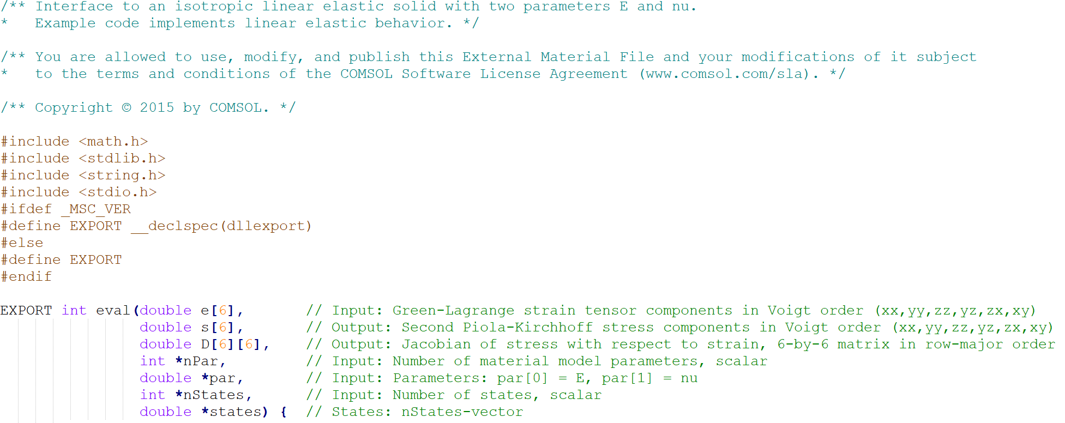
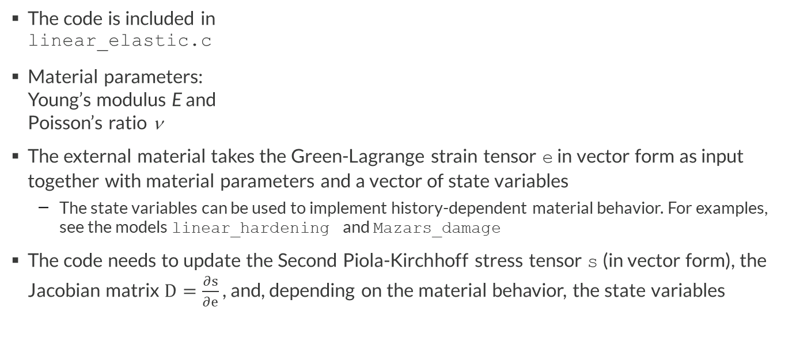
Example: Linear Elasticity
The code is included in linear_elastic.c
Material parameters: Young’s modulus E and Poisson’s ratio ν
The external material takes the Green-Lagrange strain tensor e in vector form as input together with material parameters and a vector of state variables
The state variables can be used to implement history-dependent material behavior. For examples, see the models linear_hardening and Mazars_damage
The code needs to update the Second Piola-Kirchhoff stress tensor s (in vector form), the Jacobian matrix $D=\frac{∂s}{∂e}$ , and, depending on the material behavior, the state variables

Slide 6
Validation with Built-in Implementation
The External Material code is validated against the built-in implementation of a Linear Elastic Material in COMSOL Multiphysics
To associate the External Material to a domain, add an External Stress-Strain Relation feature under the Solid Mechanics interface
The results from the two implementations are compared for a uniaxial tension test on a cylindrical sample
Note that the External Stress-Strain Relation feature will force the study to be geometrically nonlinear; the model can therefore be interpreted as a St Venant-Kirchhoff material

Slide 7
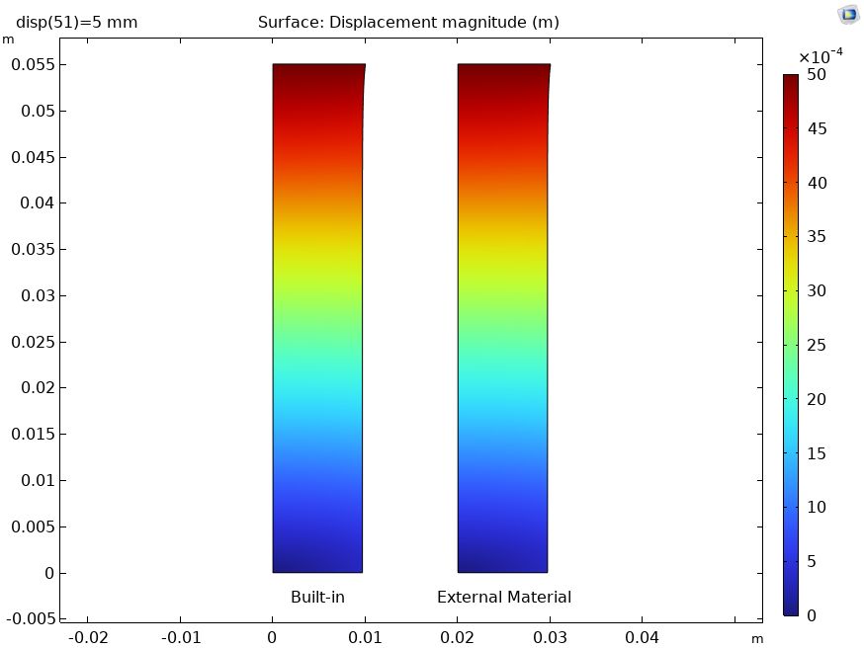
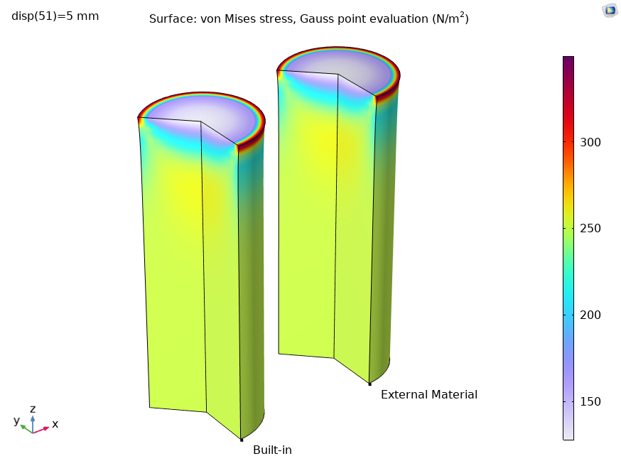
Results

